Slide 1
Extending the Motulsky & Mahan Method: Rapidly-dissociating compounds
We help you analyze your pharmacology data
Sam Hoare, PhD
sam.hoare@pharmechanics.com
October 17 2018

Slide 2
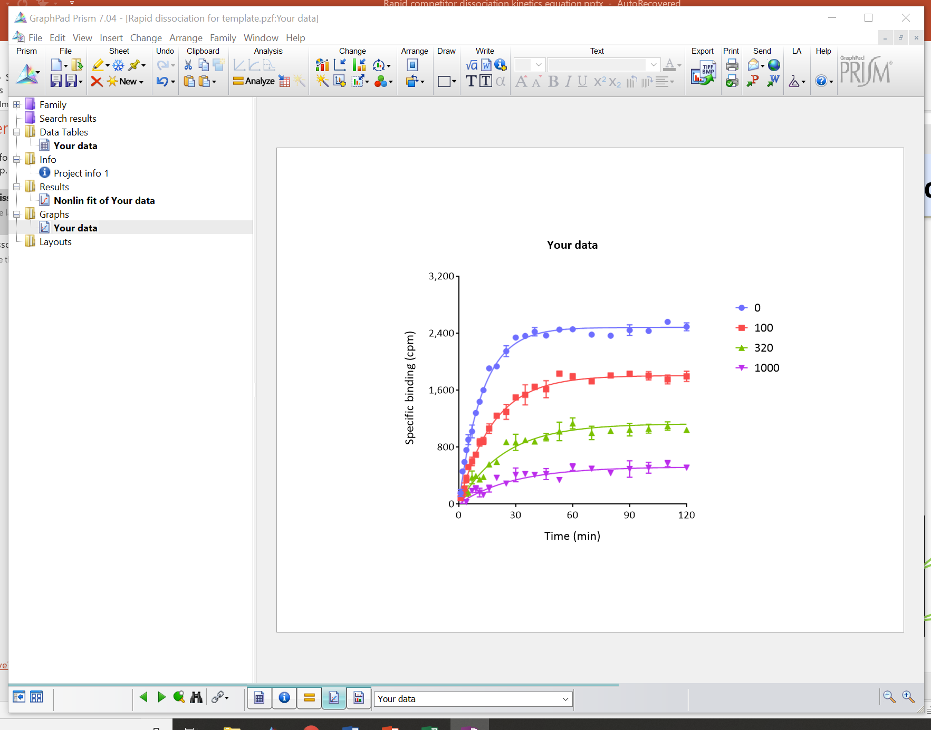
Outline
The Motulsky and Mahan equation has been adapted to accommodate a rapidly-dissociating unlabeled ligand.
This equation has been loaded into GraphPad Prism in a custom template designed by Pharmechanics.
Stimulated by discussions with:
Beth Fleck, Neurocrine Biosciences
Simeon Ramsey, Pfizer
Arturo Gonzales Moya, Cisbio
David Sykes, University of Nottingham
We are grateful to Harvey Motulsky at GraphPad Software for guidance.

Slide 3
Notes
The Prism template for data analysis is available here.
In the template, the equation is loaded in and ready to use.
Questions? Email sam.hoare@pharmechanics.com
The equations are supported by Pharmechanics, not by GraphPad.

Slide 4
The problem with rapidly-dissociating compounds
When using the Motulsky and Mahan equation, we sometimes see fitting problems with compounds that dissociate rapidly from the receptor.
The problems encountered include very large fitted values of the rate constants and very broad confidence intervals, indicating, effectively, a failure of the fit.
It would be desirable to have an equation available that can handle rapidly-dissociating compounds, for the purpose of reporting the data from the fit, e.g. in SAR tables.
Here an equation is loaded into Prism that determines the Ki of unlabeled compounds that dissociate rapidly from the receptor.

Slide 5
Example: Dissociation t_{1/2} of 4 seconds
Simulated data
Simulation parameters:
K1, 5 × 10⁷ M⁻¹min⁻¹
L, 1 nM
K2, 0.03 min⁻¹
K3, 1 × 10⁸ M⁻¹min⁻¹
K4, 10 min⁻¹ (t_{1/2}, 4 sec)
Ki, 100 nM
Bmax, 4,000 cpm
Duplicates
Guassian error with CV of 12%
Ambiguous fit
Unrealistic K3 value
Unrealistic K4 value
Very large standard error values

Slide 6
Improvement with rapid competitor equation
Simulated data
Simulation parameters:
K1, 5 × 10⁷ M⁻¹min⁻¹
L, 1 nM
K2, 0.03 min⁻¹
K3, 1 × 10⁸ M⁻¹min⁻¹
K4, 10 min⁻¹ (t_{1/2}, 4 sec)
Ki, 100 nM
Bmax, 4,000 cpm
Duplicates
Guassian error with CV of 12%
Unambiguous fit
Realistic Ki value, close to simulation value
Acceptable standard error value

Slide 7
Using the new equation
Download and open “[Pharmechanics] New kinetics of competitive binding equations” from here.
The new equations are used in the same way as the “Kinetics of competitive binding” equation.
See following slides for screen clippings

Slide 8
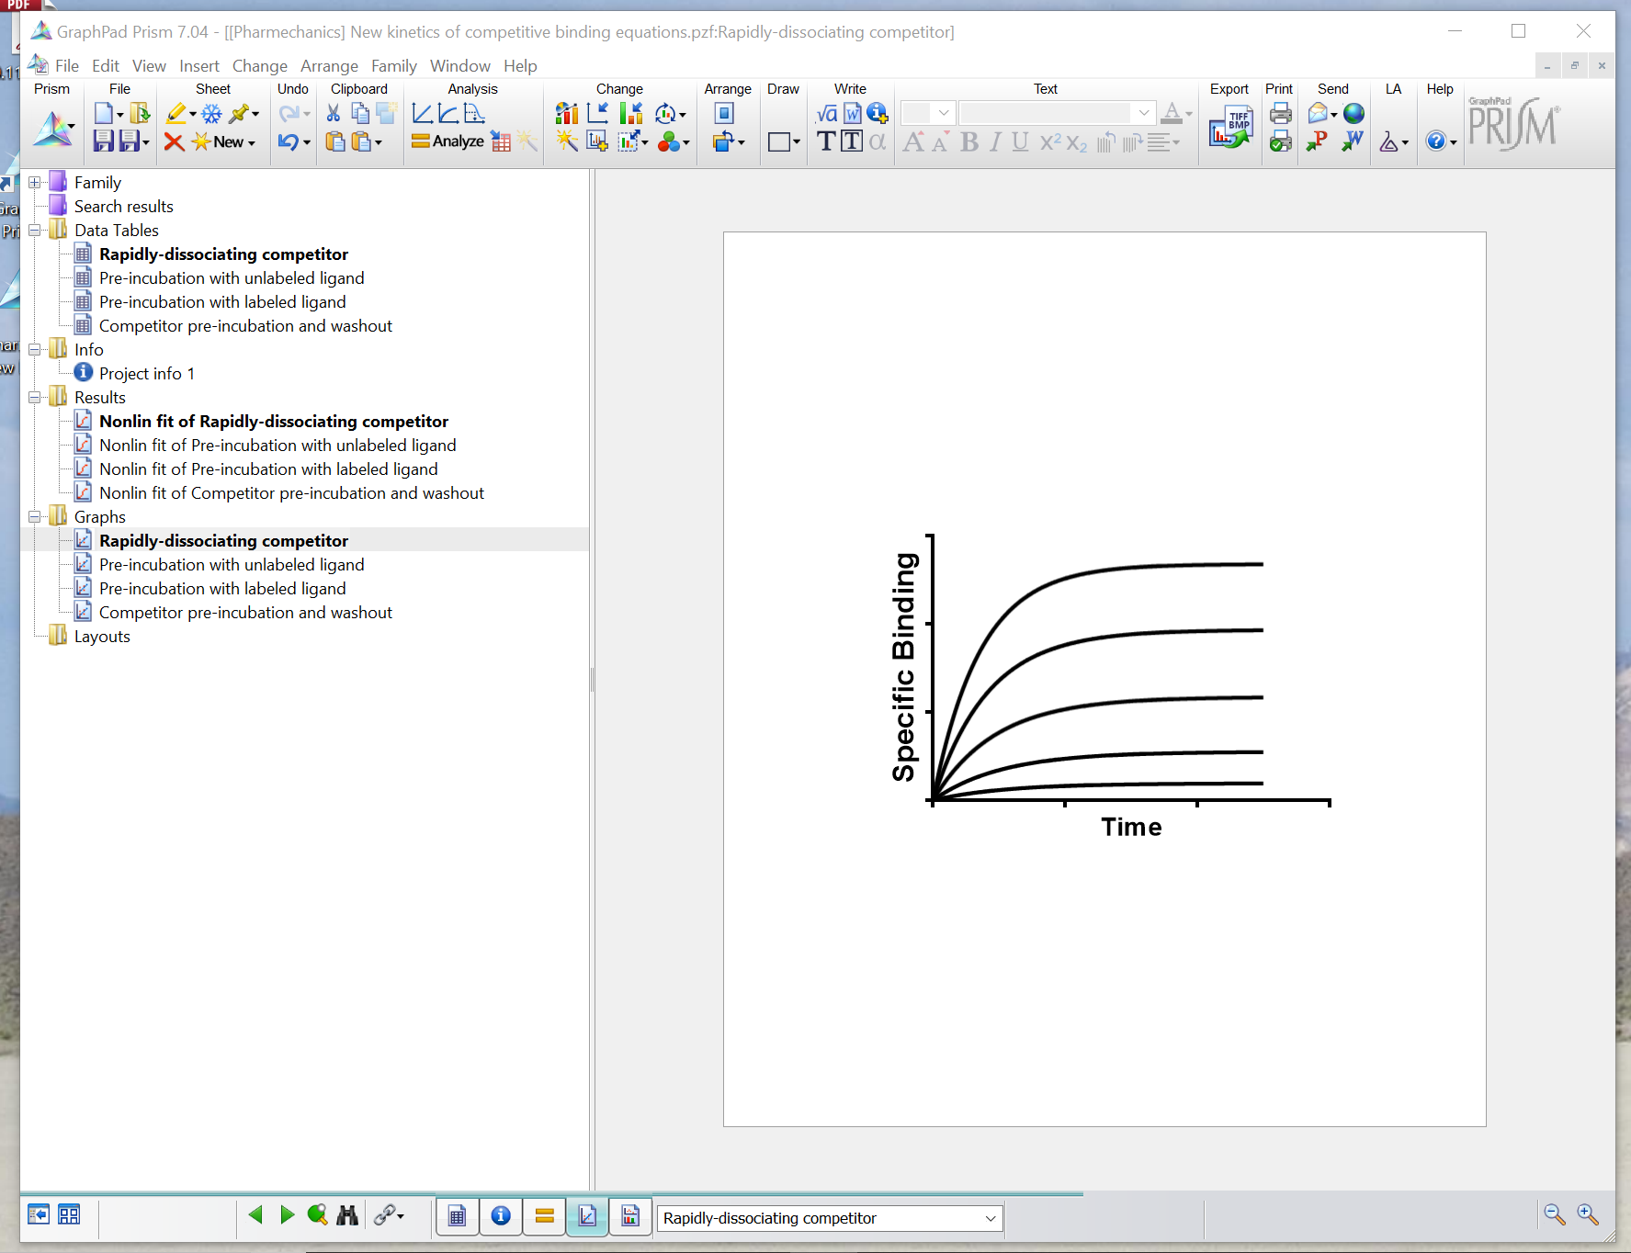
Select the equation you want

Slide 9
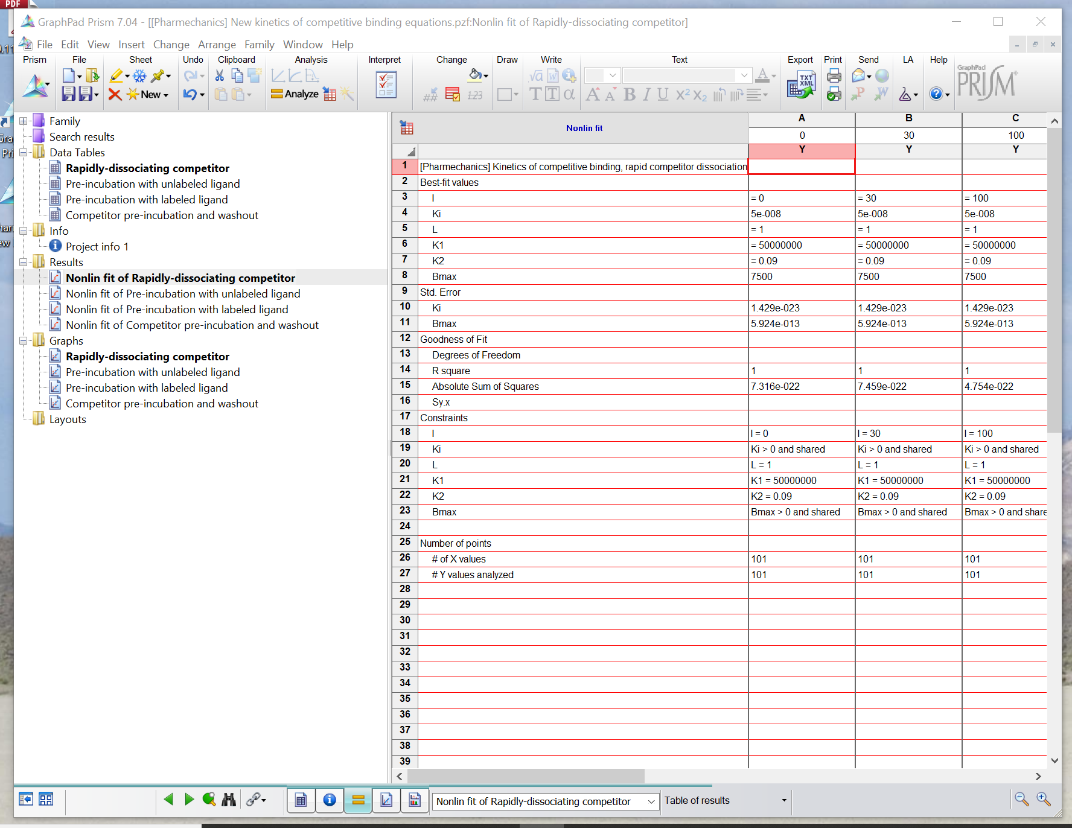
Click this icon

Slide 10
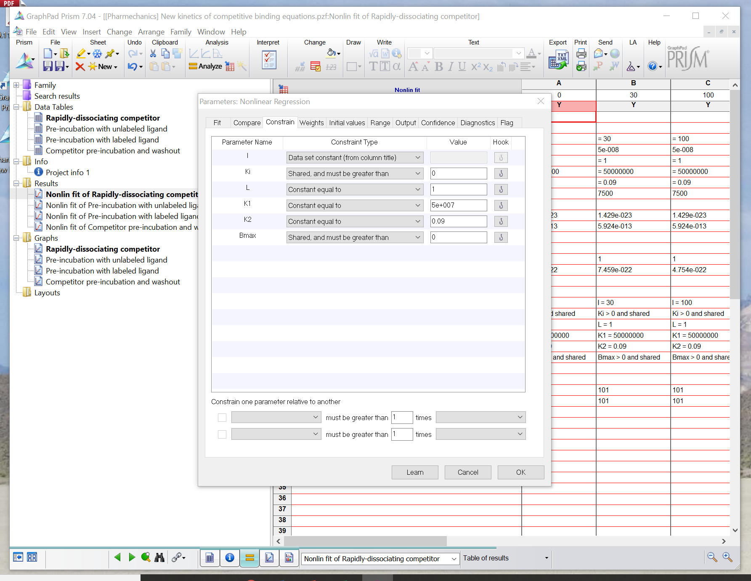
This process loads the equation into the “User-defined equations” list. It only needs to be done once. After that, the new equation will be available every time you open Prism.
Click OK then close file

Slide 11
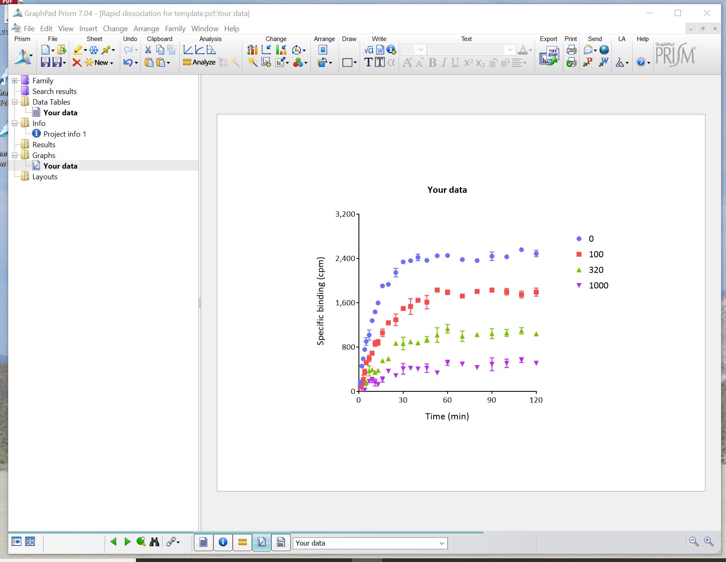
Open your file

Slide 12
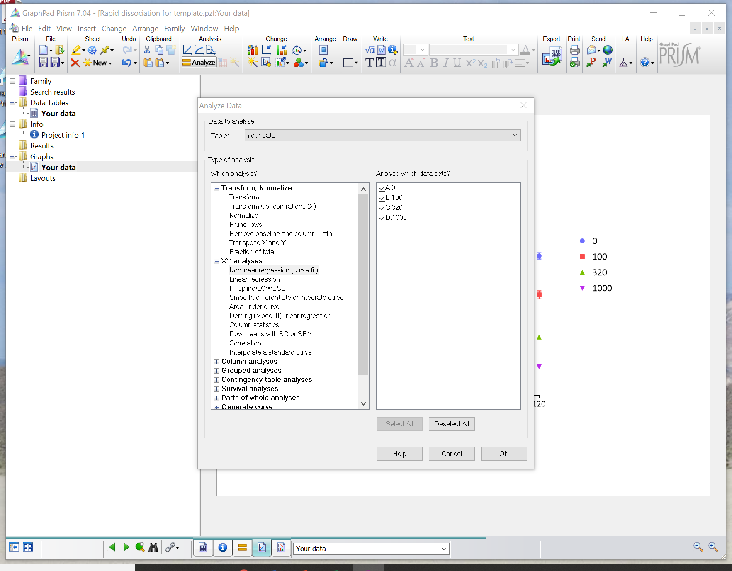

Slide 13
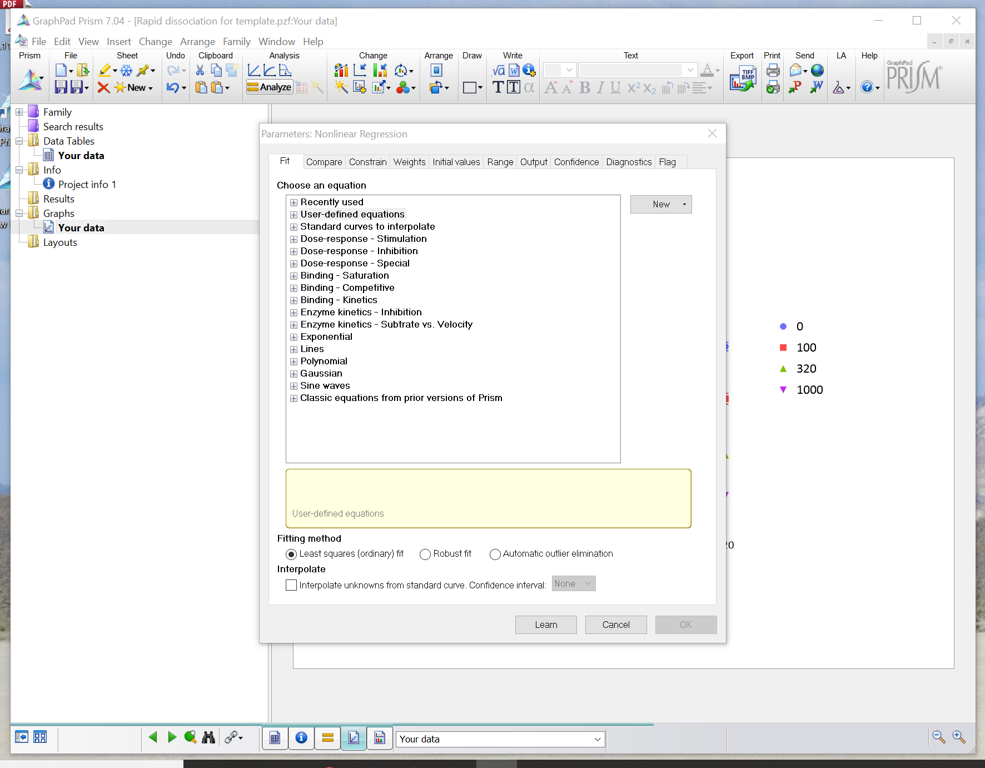

Slide 14
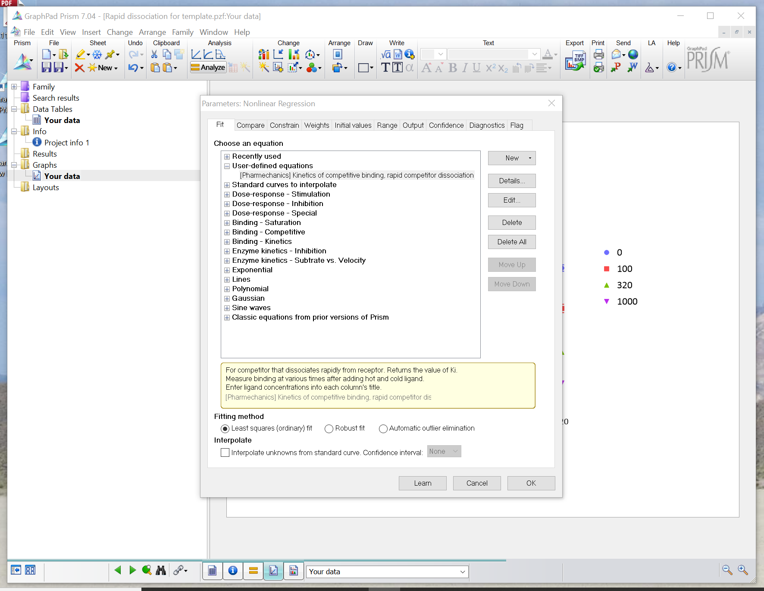
Select equation
Click Details for information on the equation

Slide 15
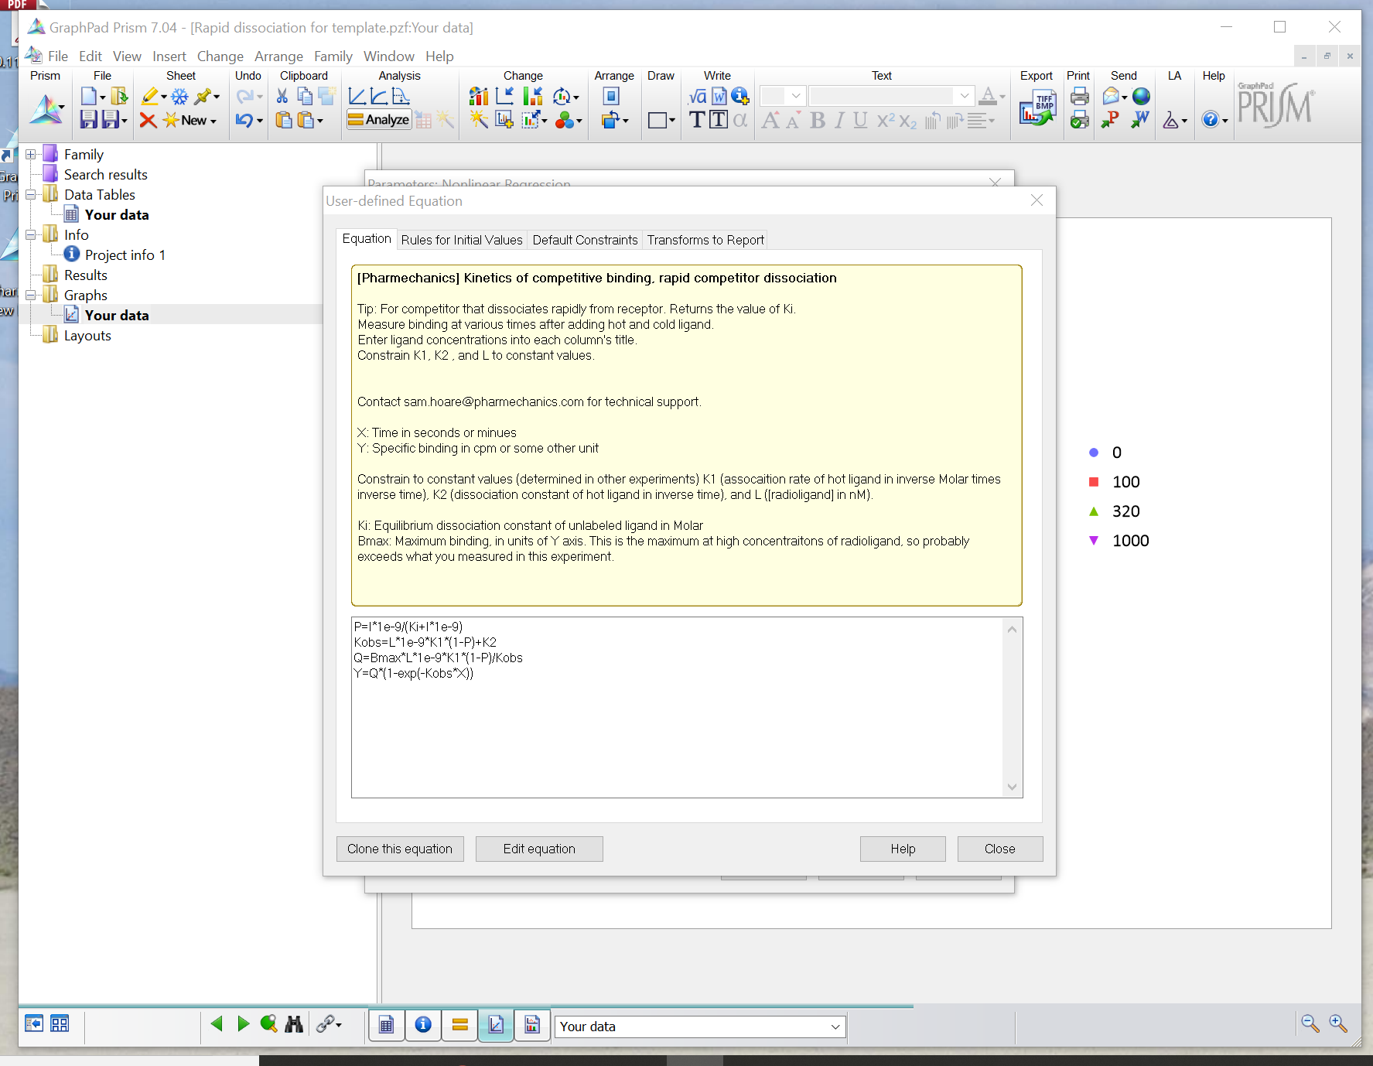
Contact Pharmechanics (not GraphPad) for technical support on the equation.
Equation formatting is the same as for the “Kinetics of competitive binding” equation

Slide 16
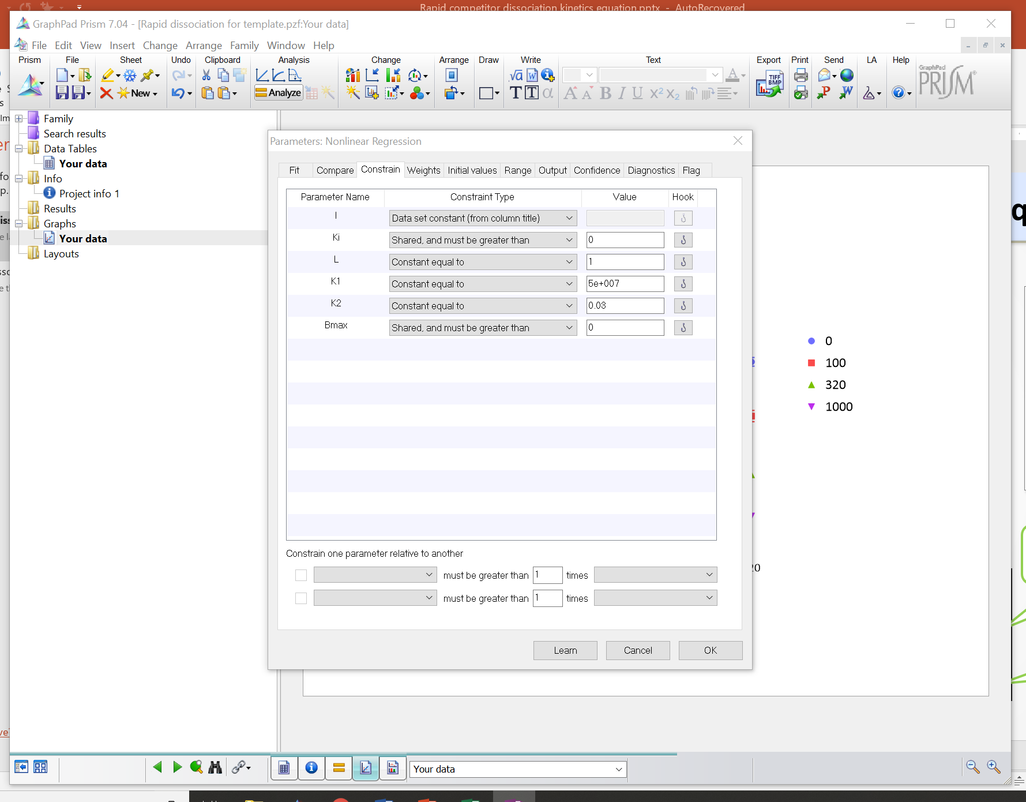
Enter your constant values
Run analysis

Slide 18
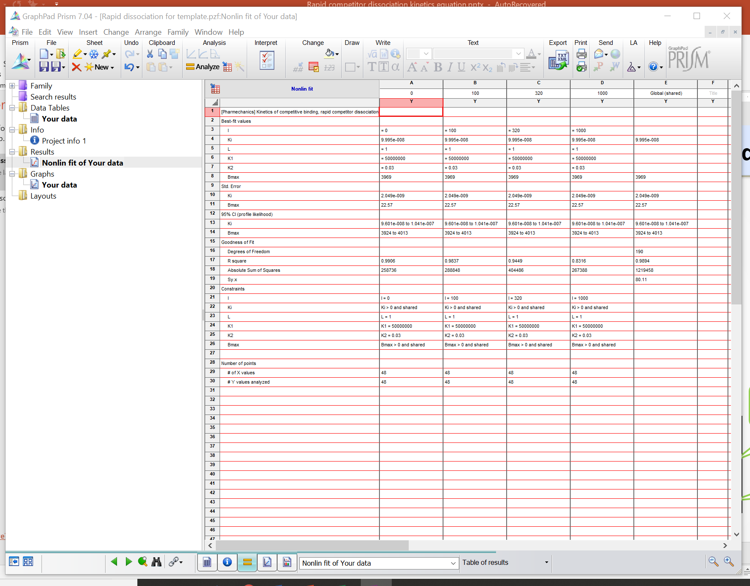

Slide 19
Summary and further information
The Motulsky and Mahan method has been adapted to accommodate a rapidly-dissociating competitor.
Contact & website
sam.hoare@pharmechanics.com
www.pharmechanics.com
Original Motulsky & Mahan paper
Mol Pharmacol. 1984; 25(1):1-9

